Slide 1

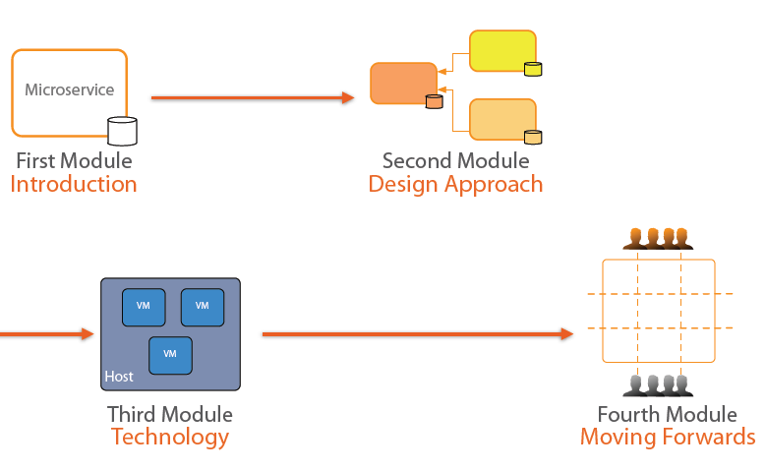
Microservices Architecture

Slide 2
Topics
What is a Service and Service Oriented Architecture ?
What Services offer ?
The Monolithic - SOA
Emergence of Microservices
Design Principles and Design Approach
Technology used to implement Microservices
Moving forward with micro-services
Architecture difference between SOA, SaaS and Micro services
Examples of SaaS
Lets play with Docker

Slide 3
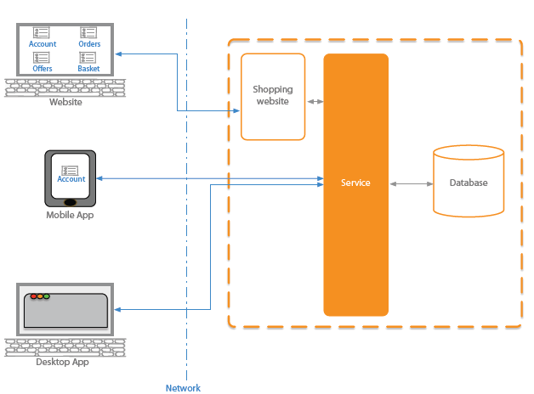
Introduction
What is a Service and Service Oriented Architecture (SOA)?
Service is a piece of software which provides functionality to other software components, like a website or a mobile app.
E.g.: Shopping cart site or Shopping cart mobile app may be using same set of services to cater for creation, updates, deletion and retrieval of orders from the database.
Communication between software components and a service happens over a network, using HTTP protocol.
System which uses service or multiple services is known to have Service oriented Architecture (SOA)
Main idea behind SOA is, instead of using packaged modules within each client application, it uses common reusable services to provide same functionality to different client applications.

Slide 4
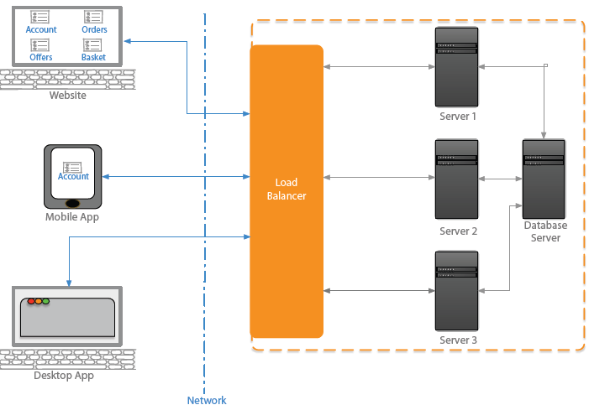
Services
What Services offer?
Scalability – having copy of a service on multiple servers in load balanced environment provides the capability of running multiple instances of the service.
So when traffic increases, the load balancer would redirect the request to a specific instance of the service running on each of the multiple servers.
Reusability – referring to the same shopping cart website or a mobile app using same set of web services for order updates etc.
Standardized interfaces or methods - where parameters to call the method remains same, which helps to upgrade the services without having to upgrade the clients application (like website or mobile app).

Slide 5
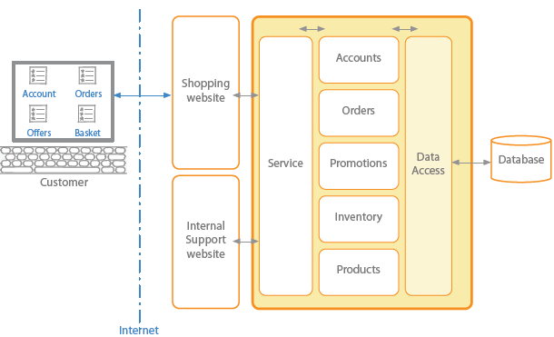
SOA - the Monolithic
Monolithic - Service Oriented Architecture
Used for typical enterprise application
No restriction on size
Large codebase
Longer development times
Challenging deployment
Fixed technology stack
High levels of coupling
Between modules
Between services
Failure could affect whole system
Scaling requires duplication of the whole
Acts as a single service on a server
Minor change could result in complete rebuild
Easy to replicate environment

Slide 6
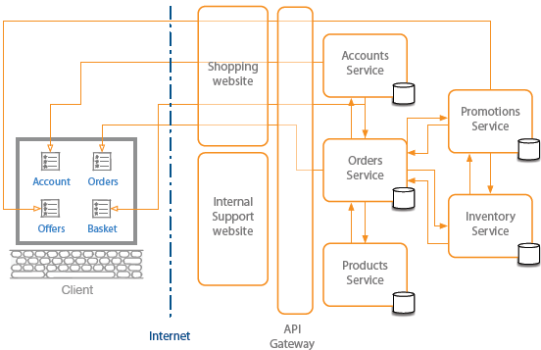
Emergence of Microservices
Why microservices?
Need to respond to change quickly
Need for reliability
Business domain-driven design
Automated test tools - like Jmitter, BlackDuck
Release and deployment tools – Like Jenkins
On-demand hosting technology – like OpenShift
Online cloud services or VMs like AWS, Azure, GCP
Need to embrace new technology – like SprintBoot, GoLang
Asynchronous communication technology – like Vert.x or Node.js platform
Simpler server side and client side technology

Slide 7
Emergence of Microservices
Benefits:
Shorter development times
Reliable and faster updates
Decouple the changeable deployment
Enables frequent parts
Security
Increased uptime
Fast issue resolution
Highly scalable and better performance
Better ownership and knowledge
Right technology
Enables distributed teams

Slide 8

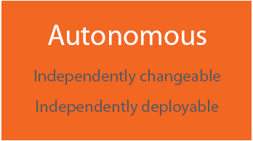
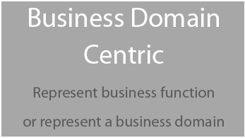
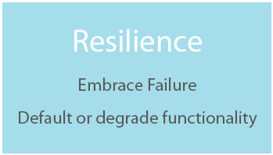
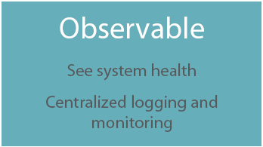
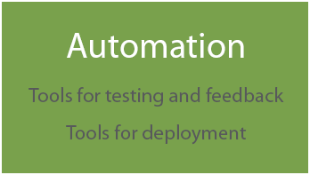
Microservices
Design Principles and Design Approach

Slide 9
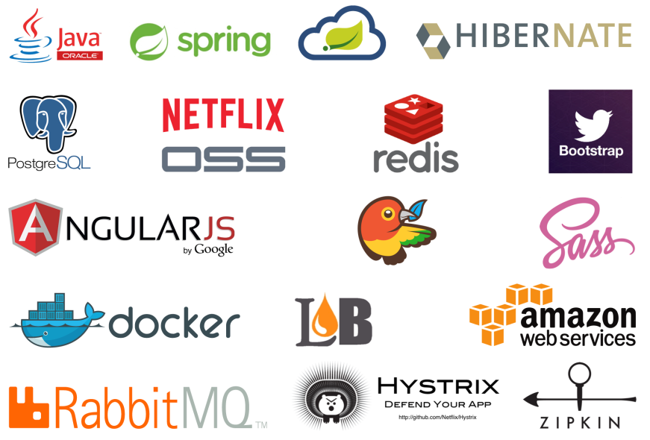
Microservices
Technology used to implement Microservices
Communication
Synchronous – Dependent services
Asynchronous – Event based services
Hosting Platforms
Virtualization – VM or Cloud hosting in Microsoft Azure, Amazon Web Services, etc.
Containers – Docker, Rocker, Glassware.
Self Hosting – using container
Registry and Discovery
Observable Microservices
Monitoring Technology – like: Nagios, PRTG, New Relic
Logging Technology – like: Elastic log, Logstash, Splunk, Kibana, Graphite
Performance
Scaling - based on Performance issue, Monitoring data or Capacity planning
Caching – to reduce server side calls
API Gateway – Load balancing , caching, routing to specific instance of a service etc.
Automation Tools
Continuous Integration – like Jenkins, TeamCity, are both CI/CD tools
Continuous Deployment- like Go CD

Slide 10

Microservices
Moving forward with Microservices
These are some of the popular applications which are using microservices:

Slide 11
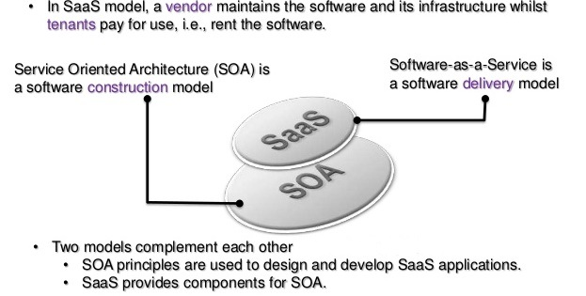
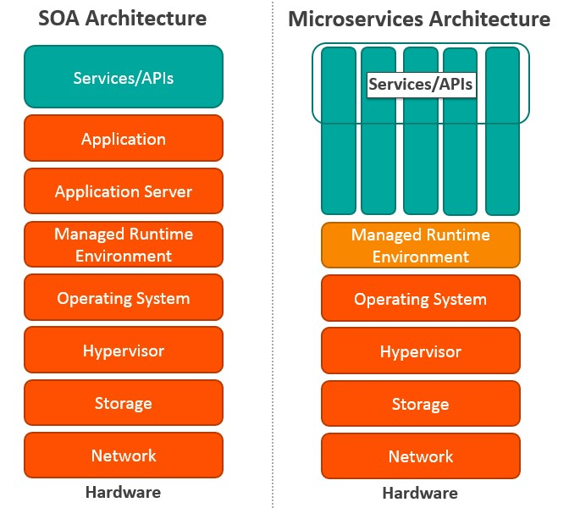
Microservices
Architecture difference between SOA, SAAS and Micro services

Slide 12
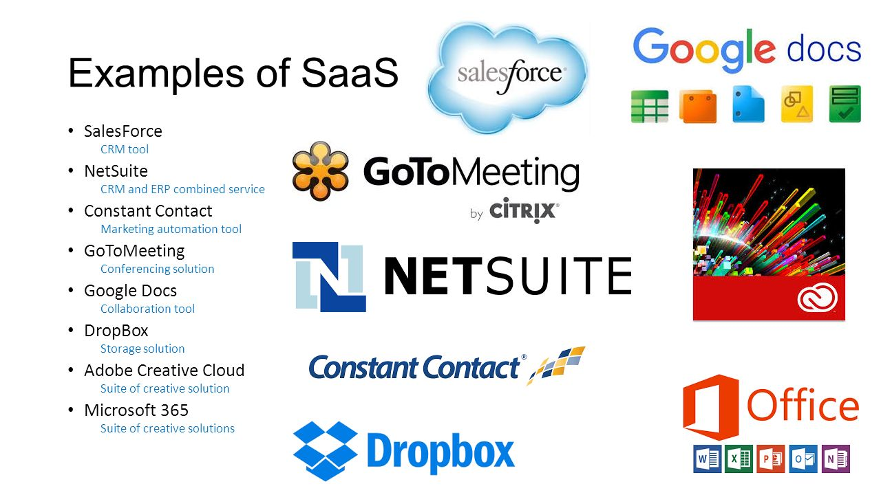
Microservices

Slide 13
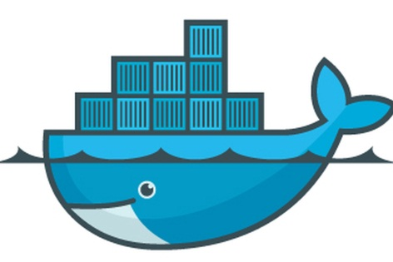
Microservices
Lets play with Docker
Docker is a container management service. The whole idea of Docker is for developers to easily develop applications, ship them into containers which can then be deployed anywhere.
Docker is an excellent tool for managing and deploying microservices.
Steps:
Go to https://labs.play-with-docker.com/
Initially it will ask you to Login
On clicking Login, it will take you to Docker login page and you need to create account at https://hub.docker.com/
Then after signup it will allow you to login to Docker labs.

Slide 14

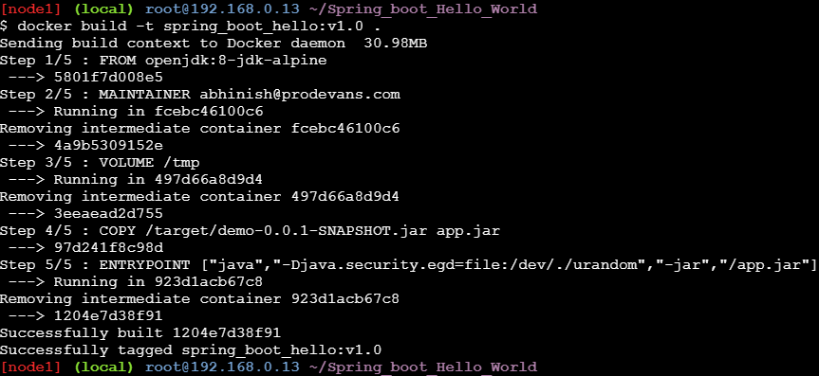
Microservices
Lets play with Docker
We have 3 different hello-worlds code available in github at the following paths:
https://github.com/Abhinish-prodevans/Spring_boot_Hello_World.git
https://github.com/Abhinish-prodevans/Python_Hello-world.git
https://github.com/Abhinish-prodevans/Node.js_Hello-world.git
Use the GIT clone command from the labs console and then the related code will be available to at the respective directory. Change the directory to the path say,
Next, use the following Docker commands:
$ docker build -t ImageName:TagName dir

Slide 15
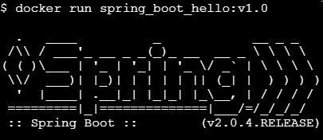
Microservices
Lets play with Docker
The docker build command takes the parameters from a file called Dockerfile.
$ docker images
It will give the output as follows:
Then you need to run the the docker image as follow
$ docker run <imageName:tagNo.>
It will give the output as follows:
Note: Please refer to the Readme file for more docker commands.

